Slide 1
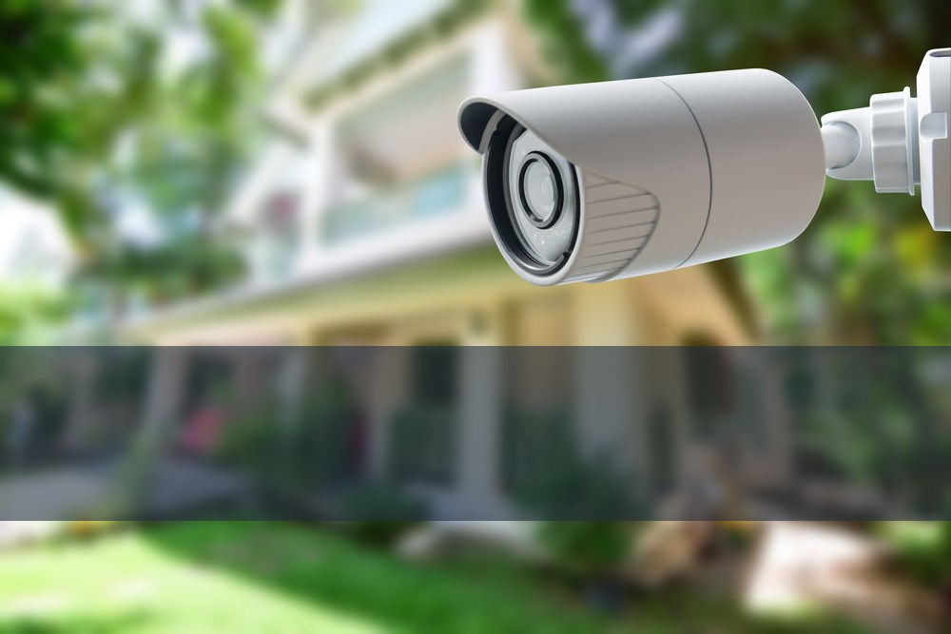

Home Security System
Capstone Project

Slide 2
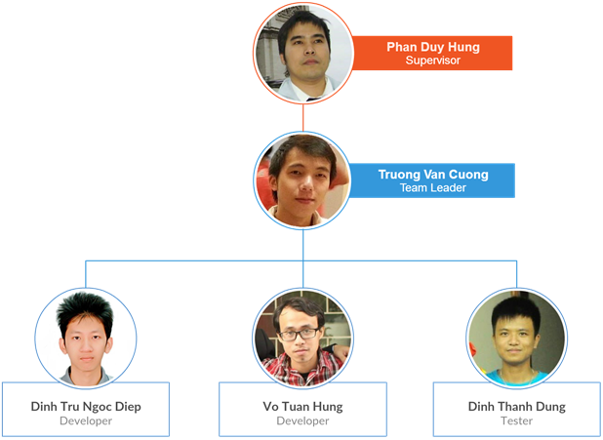
the people

Slide 3
CONTENTS
1
Introduction
Details about project Home Security System
System Requirements
2
Comprehensive description of requirements
3
System Design
How to develop ideas
Future Works
4
Discussion about the future of HSS
5
Demo
Run demo prototype of Home Security System
Question & Answer
6
Q&A between team and committee

Slide 4
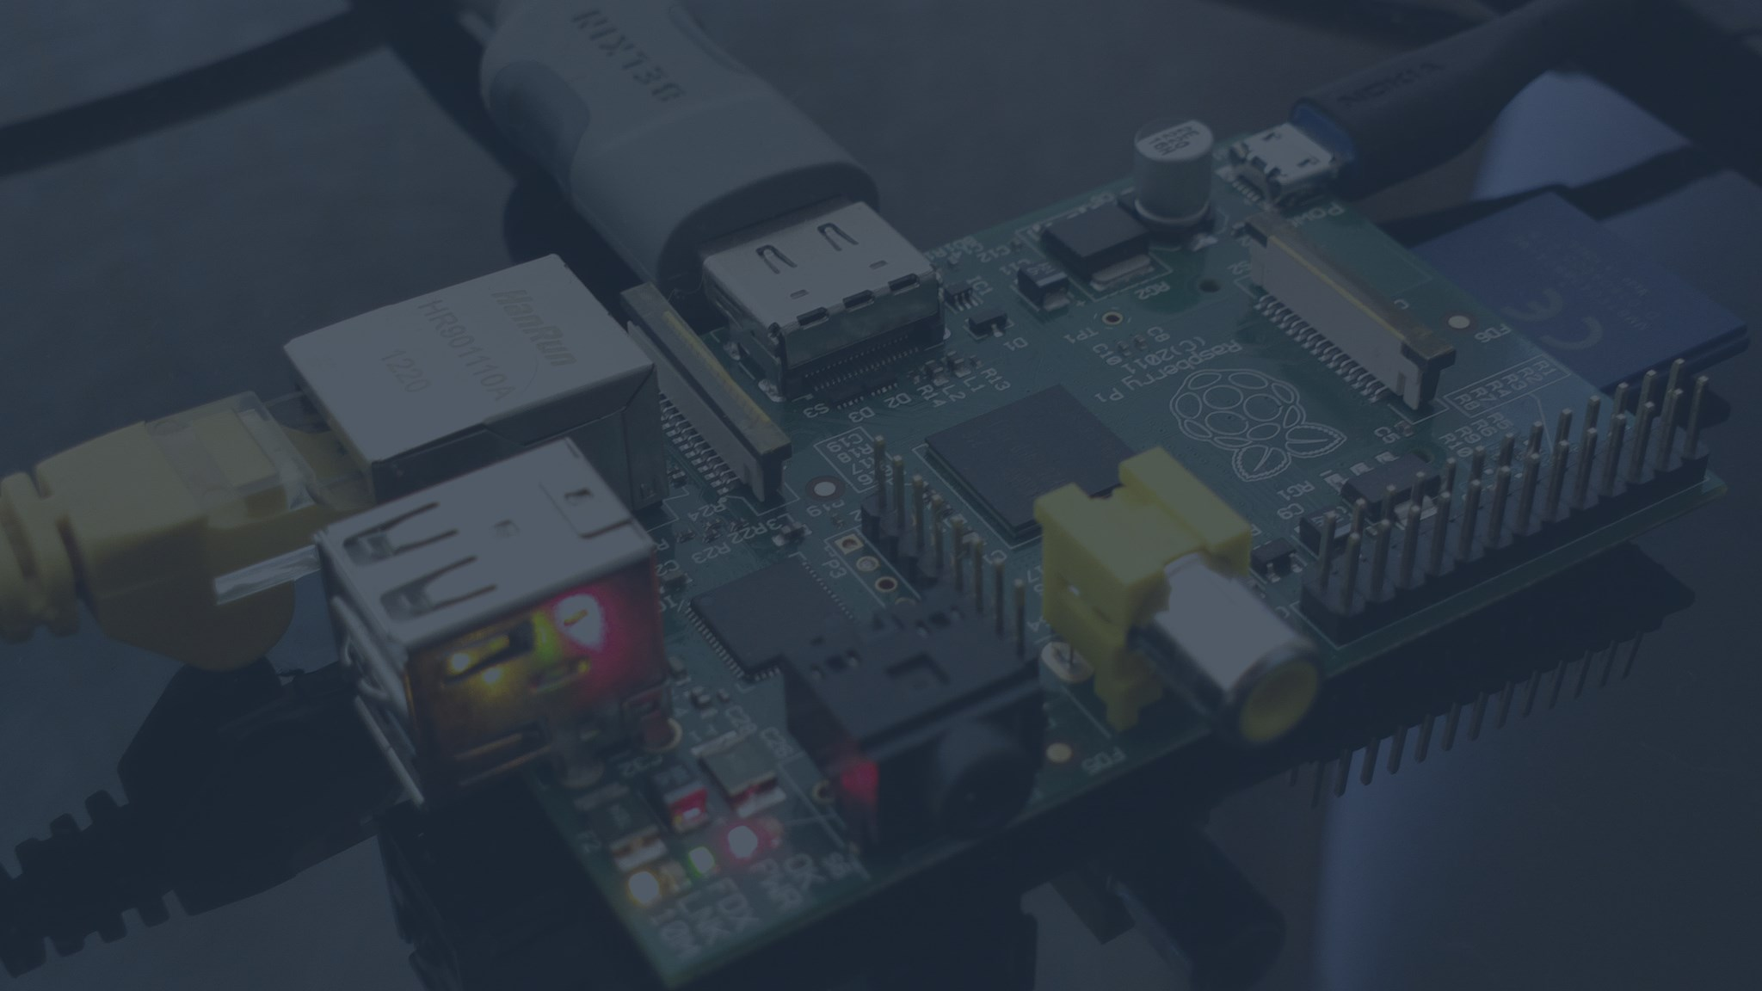
INTRODUCTION
BACKGROUND AND IDEAS
EXISTING SYSTEMS
THE SCOPE
TOOLS AND SOFTWARE

Slide 5
BACKGROUND

Slide 6
Background AND IDEAS
The term “Internet of Things” (IoT)
System of interrelated computing devices, mechanical, digital machines and objects
IoT Requirement
Transfer data over a network without human-to-human or human-to-computer interaction
Types of IoT communication
Device-to-Device Communication
Device-to-Cloud Communication

Slide 7
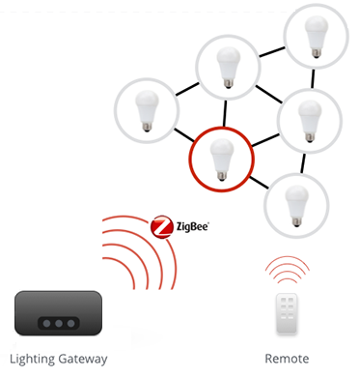
Background AND IDEAS (Cont.)
Device-to-Device communication

Slide 8
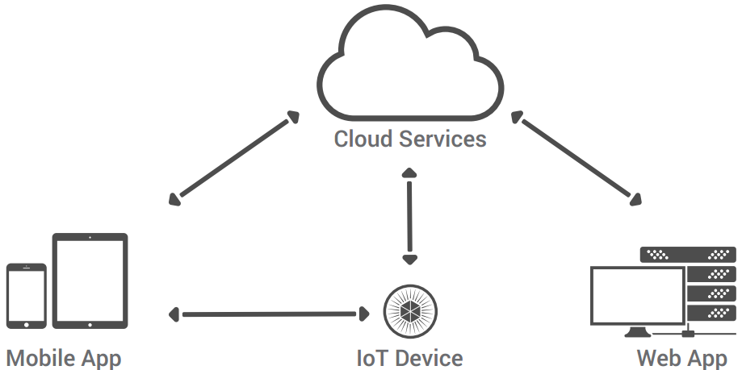
Background AND IDEAS (Cont.)
Device-to-Cloud communication
Communication Model of HSS Project

Slide 9
EXISTING SYSTEMS

Slide 10
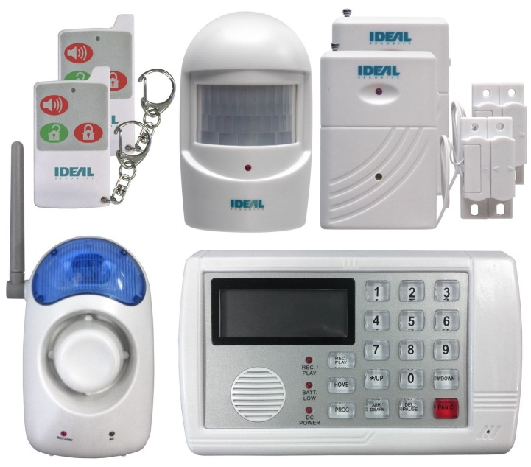


Existing systems
IDEAL Security System
$250
Working
Connect to telephone landline
Alarm by calling directly to phone
Lose memory when power failure
2 door sensors, 1 motion sensor
remote control, telephone dialer

Slide 11
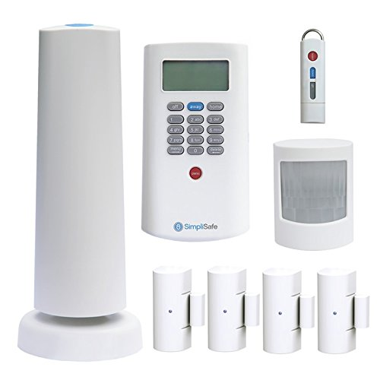
Existing systems (Cont.)
SimpliSafe House Security System
$260
$24.99/month for smartphone app
Working
Very simple to use
Plug and Play
Includes door sensors, motion detectors, CO detector, panic button for emergencies etc…

Slide 12
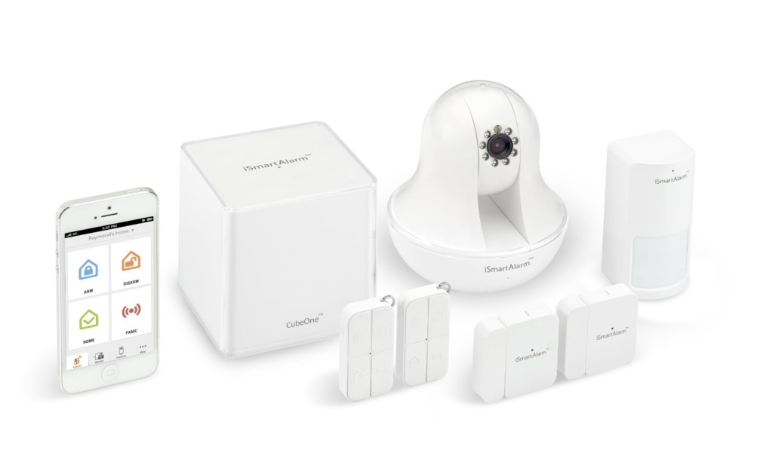
Existing systems (Cont.)
iSmartAlarm Premium Package
$199
$349 for including iCamera
Working
Smartphone application
2 door sensors, 1 motion sensor
2 remote tags
Very easy to integrate with addition sensors

Slide 13
research
“91% of people keep
their smartphone within
3 feet 24 hours a day”
- Morgan Stanley -

Slide 14




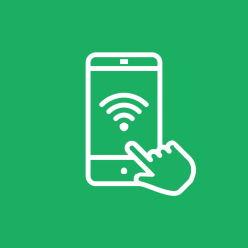

The scope
Internet
Real-time Handling
WLAN or Ethernet
Send and receive data
in real-time
Sensor
Audio Quality
64kbps
Motion and Door detection
Connection
Image Quality
HSS-Board and HSS-App
in a local network
JPEG 640x480 pixel

Slide 15








TOOLS AND Softwares
Programming Language
Tools and Software
Qt
Github
Google Drive
Astah
Arduino IDE

Slide 16
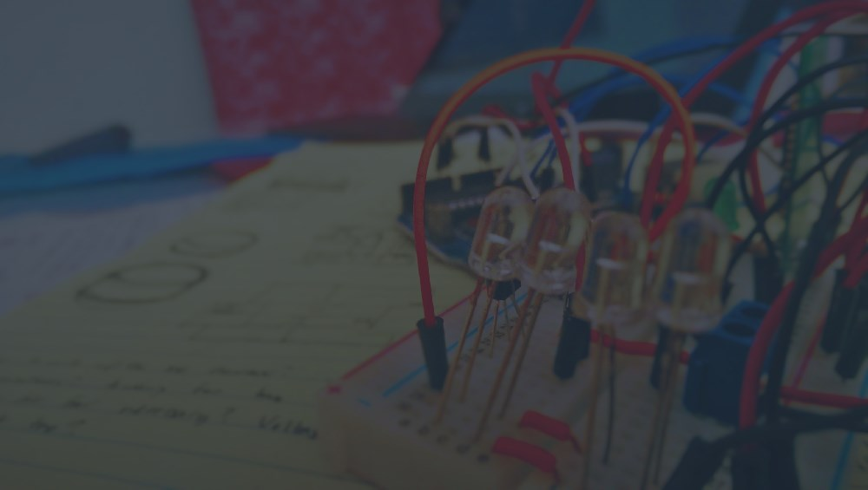
SYSTEM REQUIREMENTS
FUNCTIONAL REQUIREMENTS
NON-FUNCTIONAL REQUIREMENTS

Slide 17
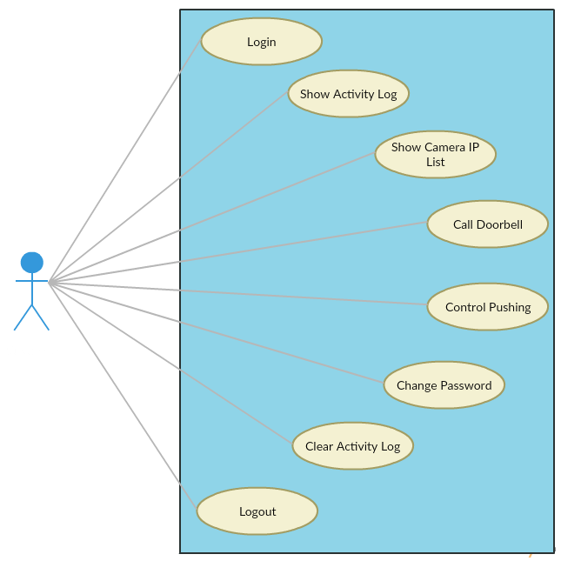
Functional requirements

Slide 18
NON-FUNCTIONAL REQUIREMENTS
Safety
The supply voltage is totally safe with user (5V)
Reliability
Availability
Low Failure Rate
Security
Always require authenticating process
Usability
Well-formed graphical UI
Informative error messages

Slide 19
SYSTEM DESIGN
SYSTEM ARCHITECTURE
HARDWARE DESIGN
SOFTWARE DESIGN

Slide 20
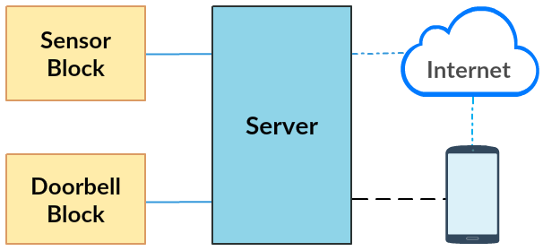
System architecture
Overview
HSS-Board: Devices in wired connection
HSS-App: Android app and third-party services

Slide 21
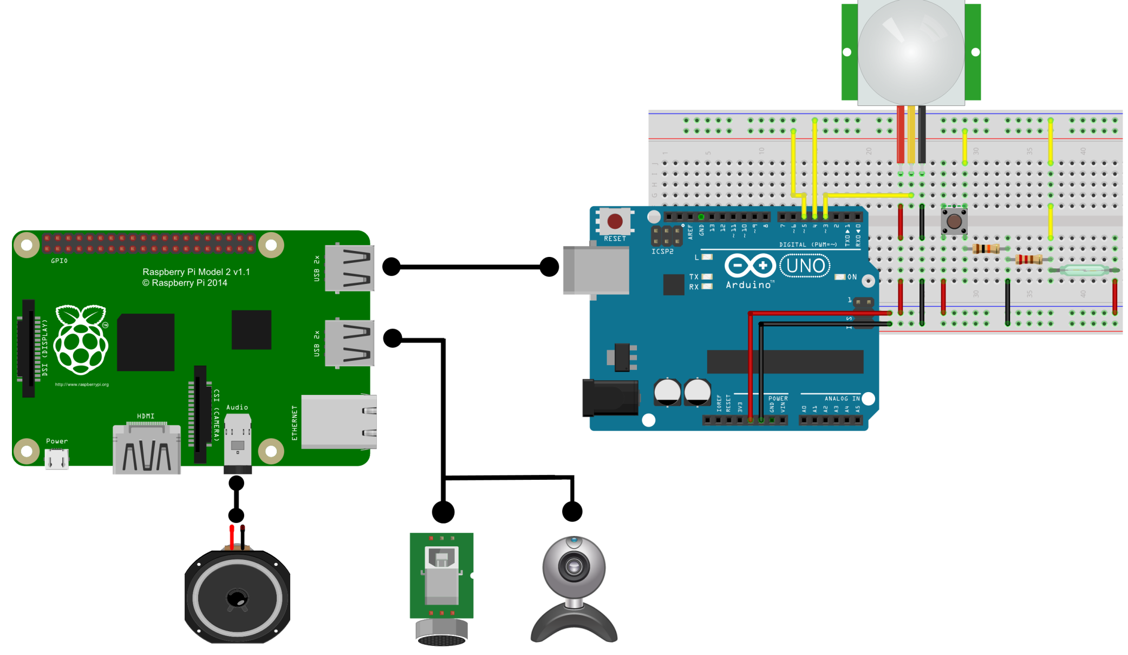
Hardware design
HSS-Board Schematic

Slide 22
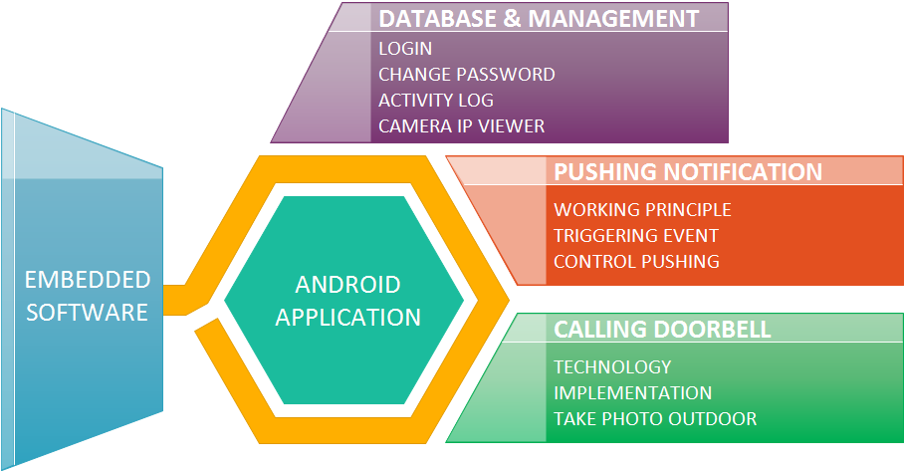
Software design

Slide 23
DATABASE
and
MANAGEMENT

Slide 24
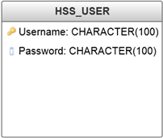
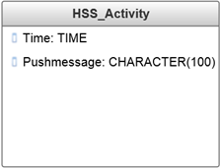
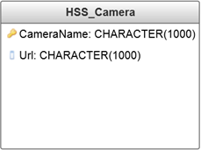
SOFTWARE DESIGN
Database
Name | Meaning
Username | Username for login
Password | Password for login
Time | Time of triggered event
Pushmessage | Message shown in Activity Log screen
CameraName | Name of Camera IP
Url | URL of Camera IP

Slide 25
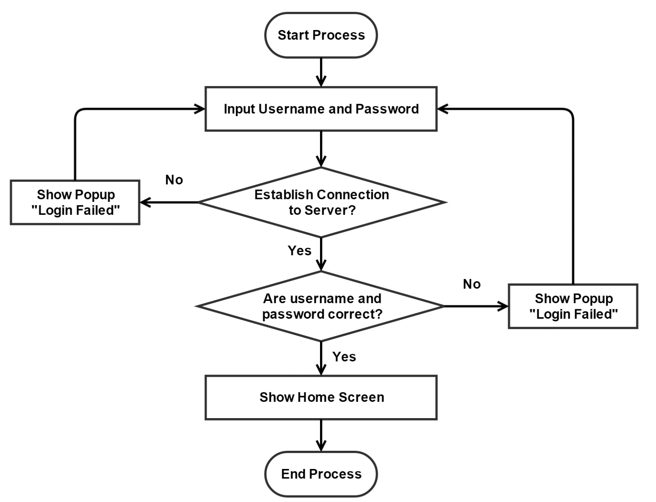
SOFTWARE DESIGN (cont.)
Login

Slide 26
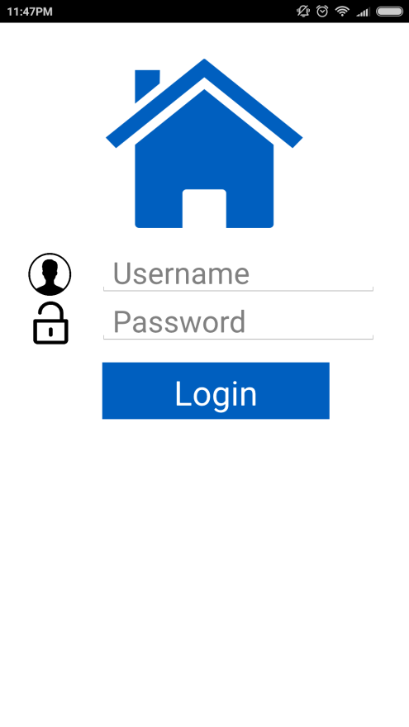
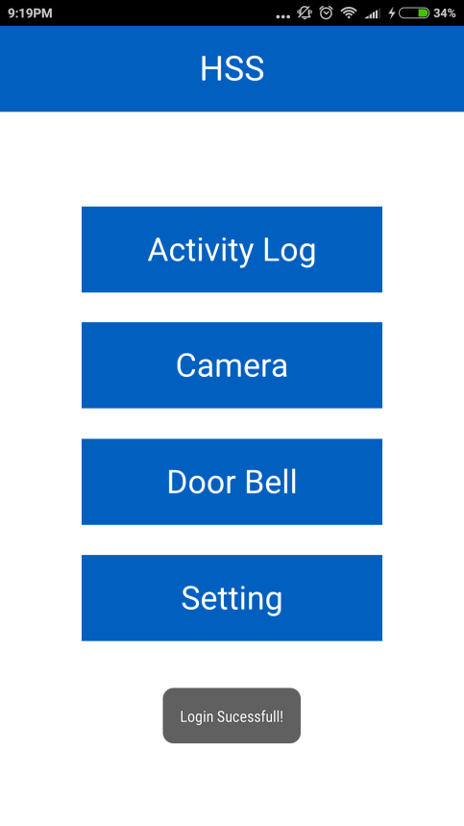
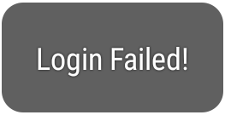

SOFTWARE DESIGN (cont.)
Login
Popup on Screen

Slide 27
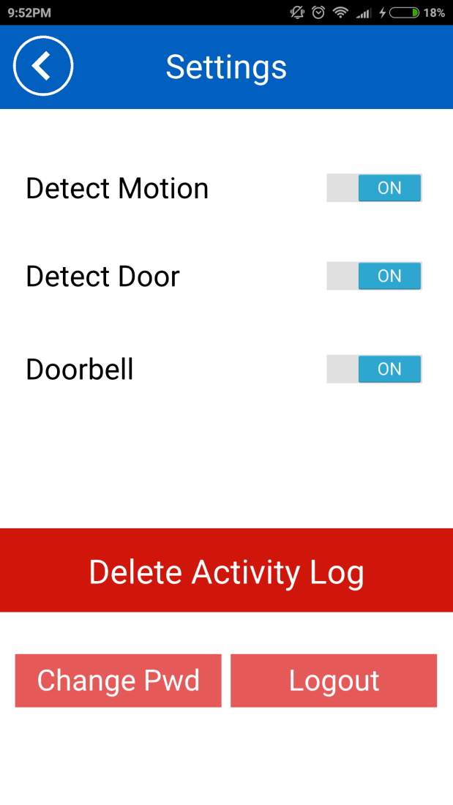

SOFTWARE DESIGN (cont.)
Change Password
Change Password Screen

Slide 28
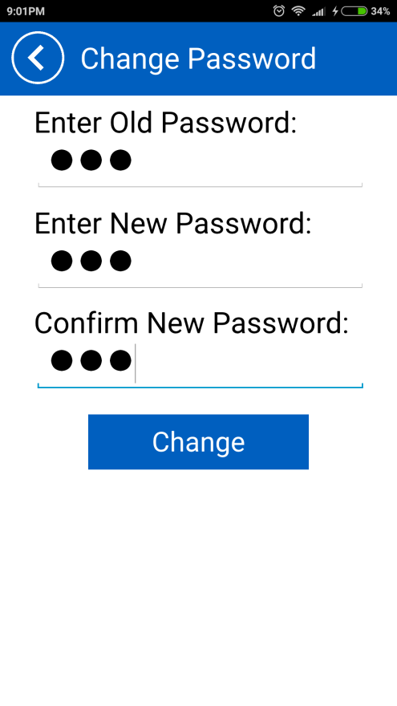
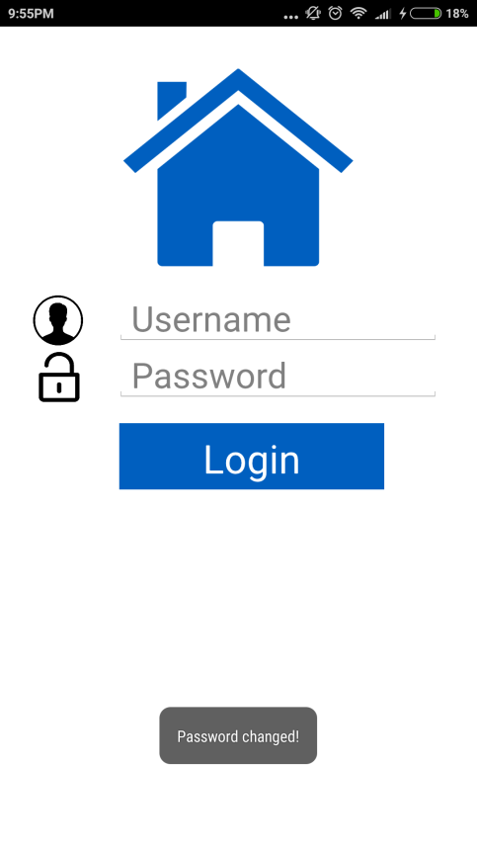
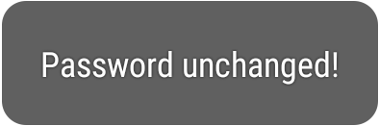
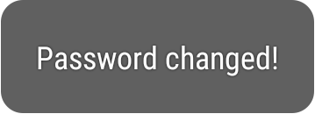
SOFTWARE DESIGN (cont.)
Change Password
Popup on Screen

Slide 29
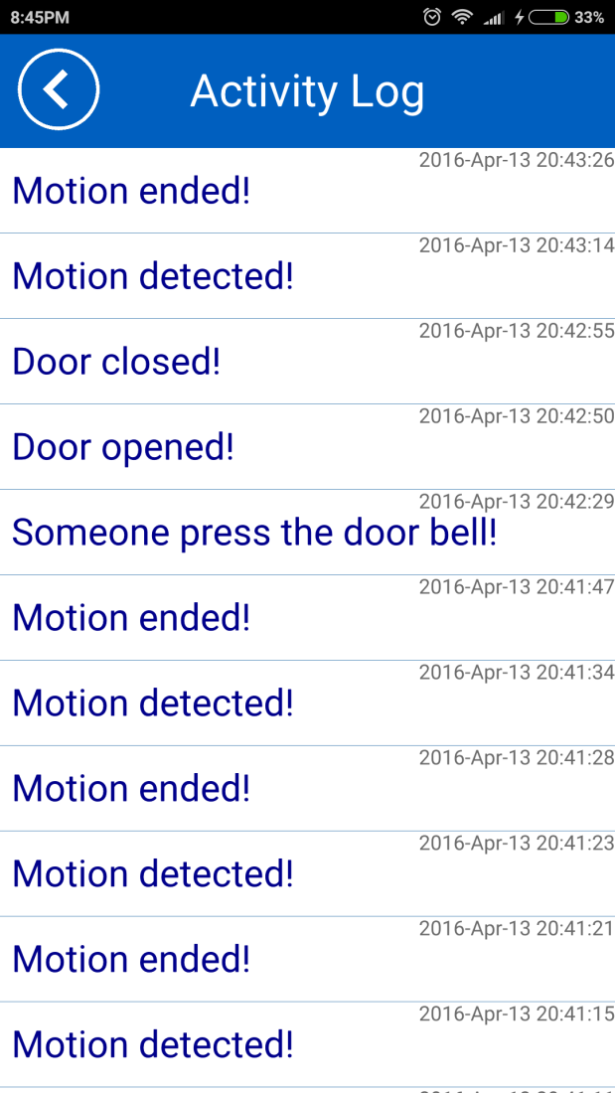
SOFTWARE DESIGN (cont.)
Show Activity Log

Slide 30


SOFTWARE DESIGN (cont.)
Delete Activity Log

Slide 31
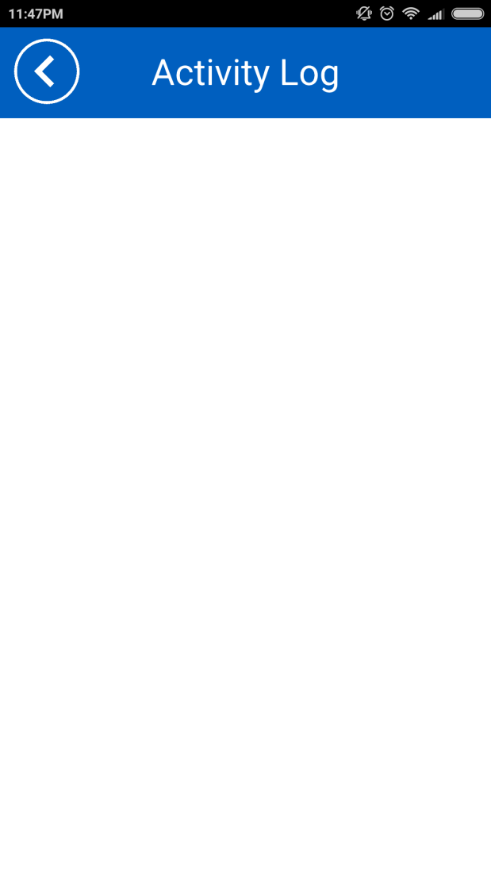
SOFTWARE DESIGN (cont.)
Delete Activity Log

Slide 32
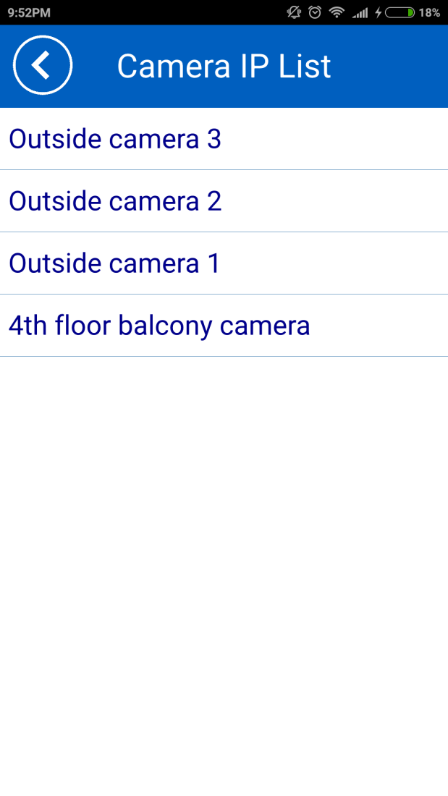
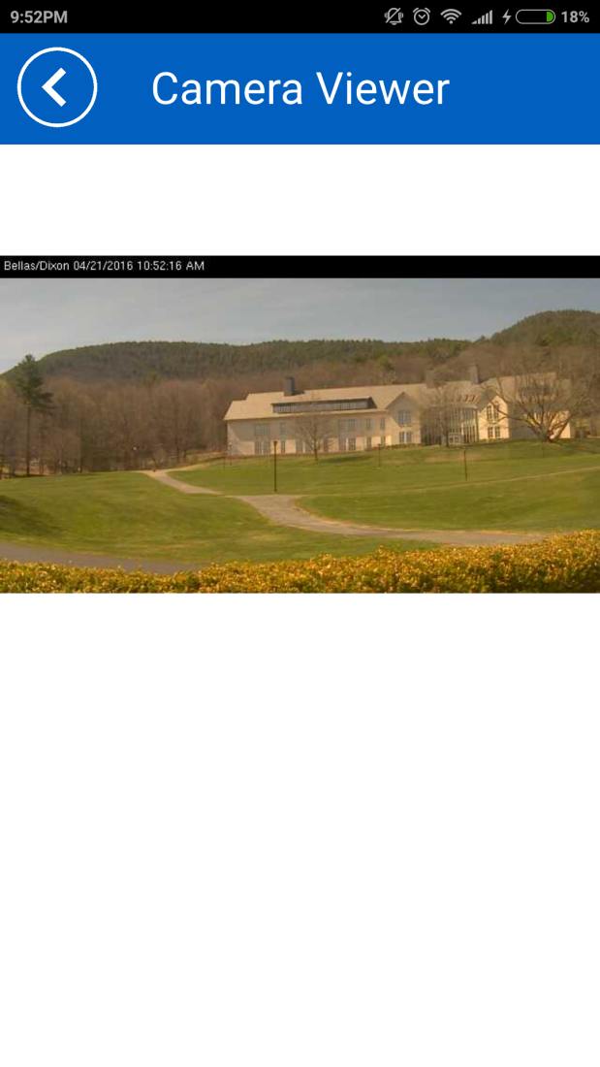
Software design (cont.)
View Camera IP

Slide 33
PUSHING NOTIFICATION

Slide 34

SOFTWARE DESIGN (cont.)
Pushing Notification
Pusher
A service for message communication between web and mobile applications
Deliver over 160 billion messages to more than 5.4 billion devices

Slide 35
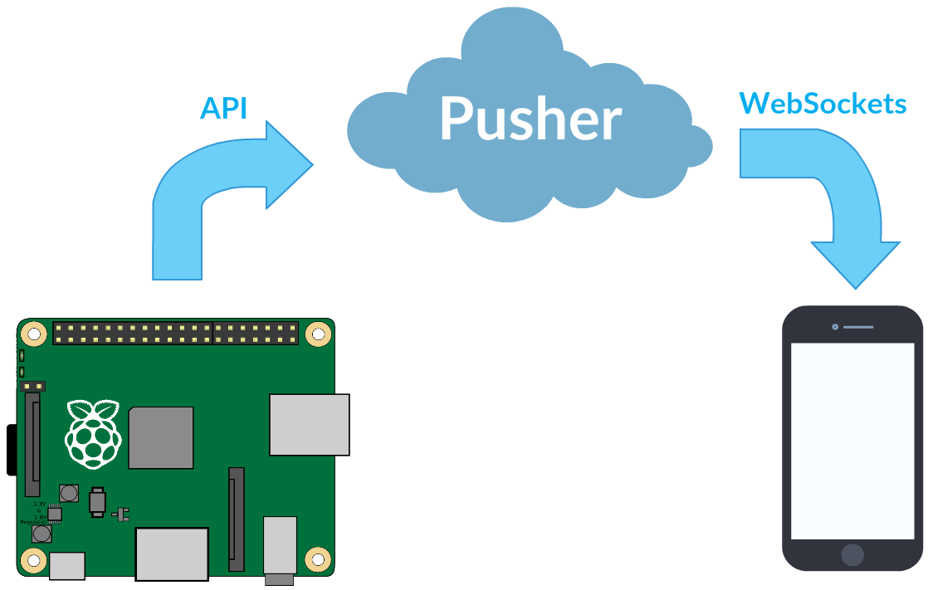
SOFTWARE DESIGN (cont.)
Pushing Notification

Slide 36
SOFTWARE DESIGN (cont.)
Pushing Notification
On Raspberry Pi
Connect to Pusher server
Send message to a channel
On HSS-App
Connect to Pusher server
Subscribe to Raspberry Pi channel
Listen for message
Show notification when message arrived

Slide 37
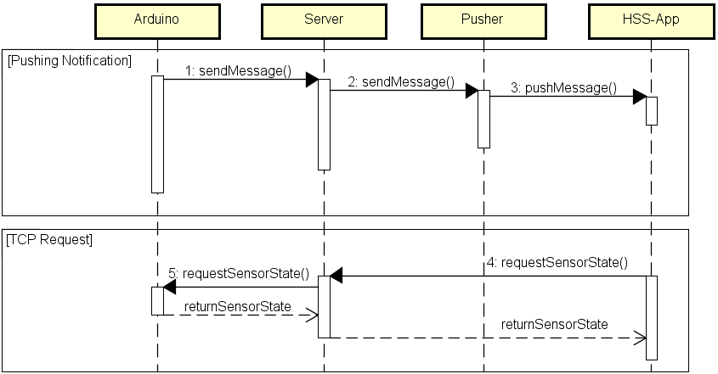
SOFTWARE DESIGN (cont.)
Client – Server Communication

Slide 38
SOFTWARE DESIGN (cont.)
Pushing Notification: Triggering Event
Sensor | Trigger | Action | Message
Button | Press or hold once | Push to HSS-App | Someone press the doorbell
Door | Change state from closing to open | Push to HSS-App | Door has been opened
 | Change state from open to close | Push to HSS-App | Door has been closed
PIR | Detecting motion | Push to HSS-App once every 5s | Motion detected
 | Motion ends | Push to HSS-App after 5s without any motion detected | Motion ended

Slide 39
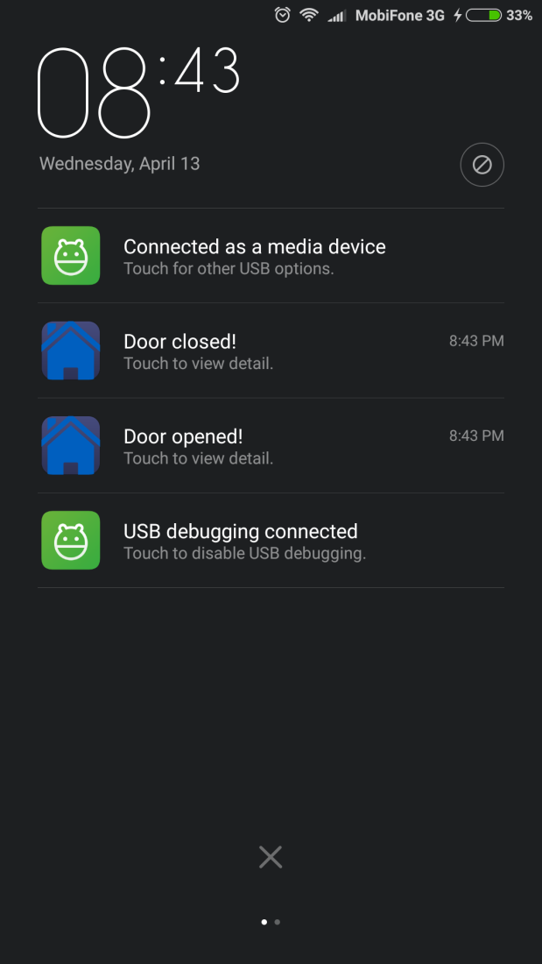
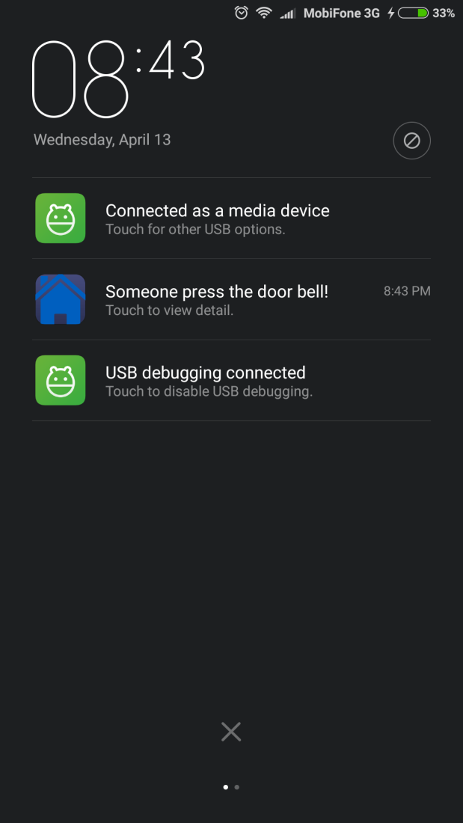
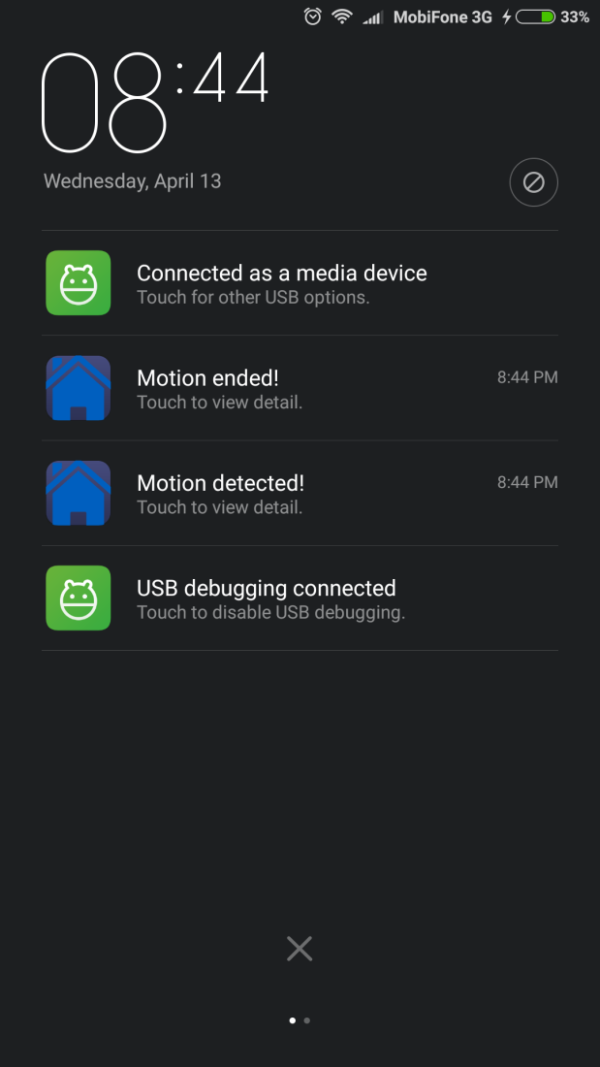
SOFTWARE DESIGN (cont.)
Pushing Notification: Sample Screen

Slide 40
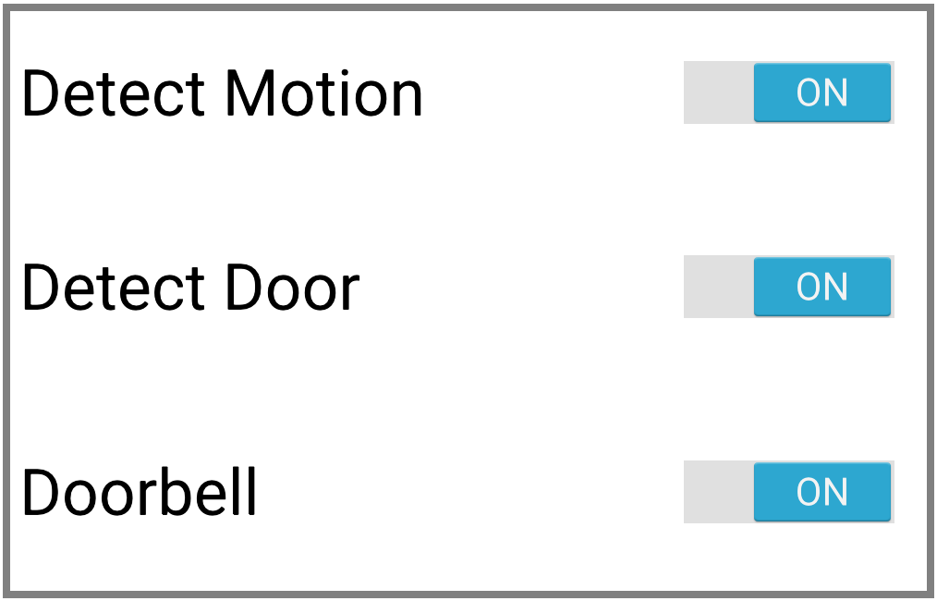
SOFTWARE DESIGN (cont.)
Control Pushing Notification

Slide 41
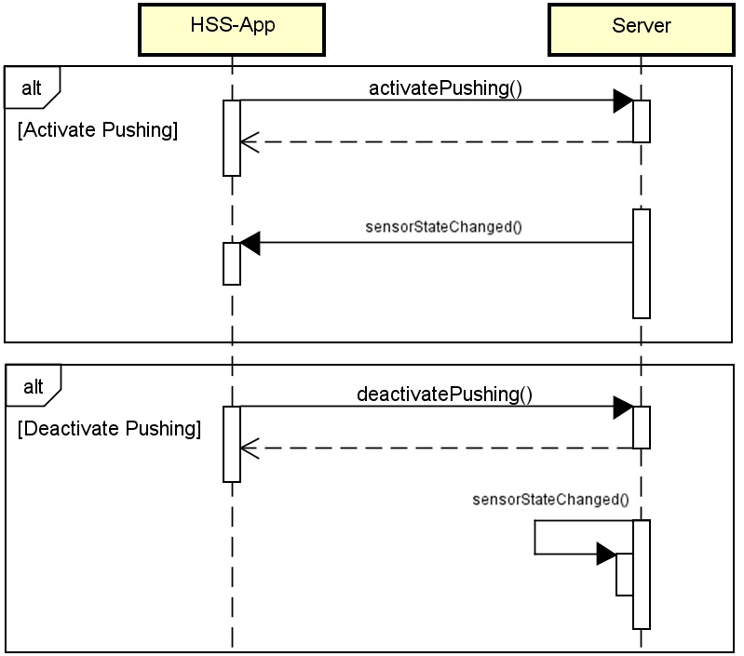
SOFTWARE DESIGN (cont.)
Control Pushing Notification

Slide 42

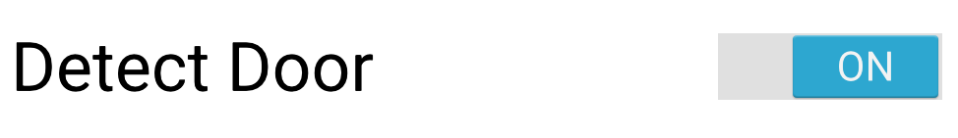
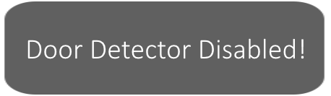
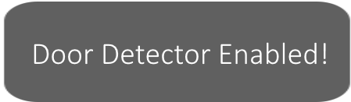
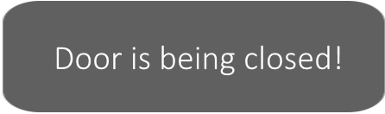
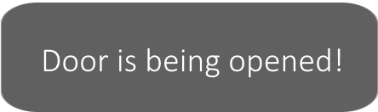
SOFTWARE DESIGN (cont.)
Check current door stte
or

Slide 43
CALLING DOORBELL

Slide 44
Software design (cont.)
Calling Doorbell
Voice over IP Technology (VoIP)
Delivery of voice communications and multimedia sessions over IP network
Providers usually offer lower rates than traditional phone
SIP (Session Initiation Protocol)
Signaling and controlling communication sessions
STUN (Session Traversal Utilities for NAT)
Assisting devices behind NAT with their packet routing
Linphone SIP Server
Free SIP service based on Flexisip proxy server

Slide 45
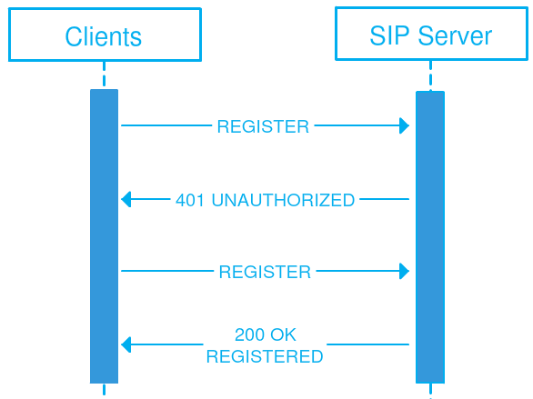
Software design (cont.)
Calling Doorbell
SIP Server in HSS
Responsible for keep registering with clients in both 2 sides: Raspberry Pi and HSS-App; then routing the connection when initiating a VoIP call (Calling to Doorbell)

Slide 46
Software design (cont.)
Calling Doorbell
On Raspberry Pi
Install Linphone module package for Python
Setting in code:
Parameter | Value
SIP Server | sip.linphone.org
STUN Server | stun.linphone.org
Auto Answer Call | Yes
Sound Input | ALSA: USB PnP Sound Device
Sound Output | Default

Slide 47
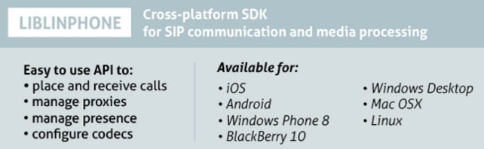
Software design (cont.)
Calling Doorbell
On HSS-App, Linphone Library and API were used for developing VoIP feature

Slide 48
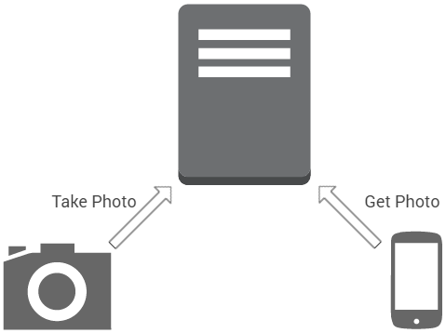
Software design (cont.)
Calling Doorbell
Take photo when someone press the doorbell
fswebcam
Apache HTTP Server

Slide 49
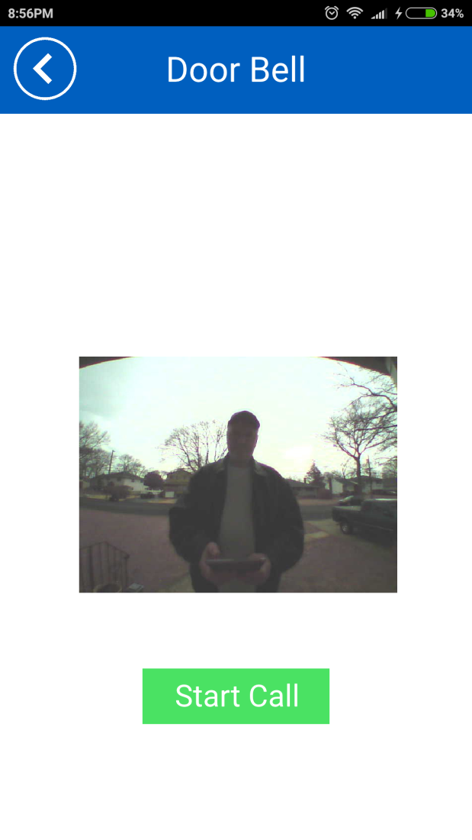
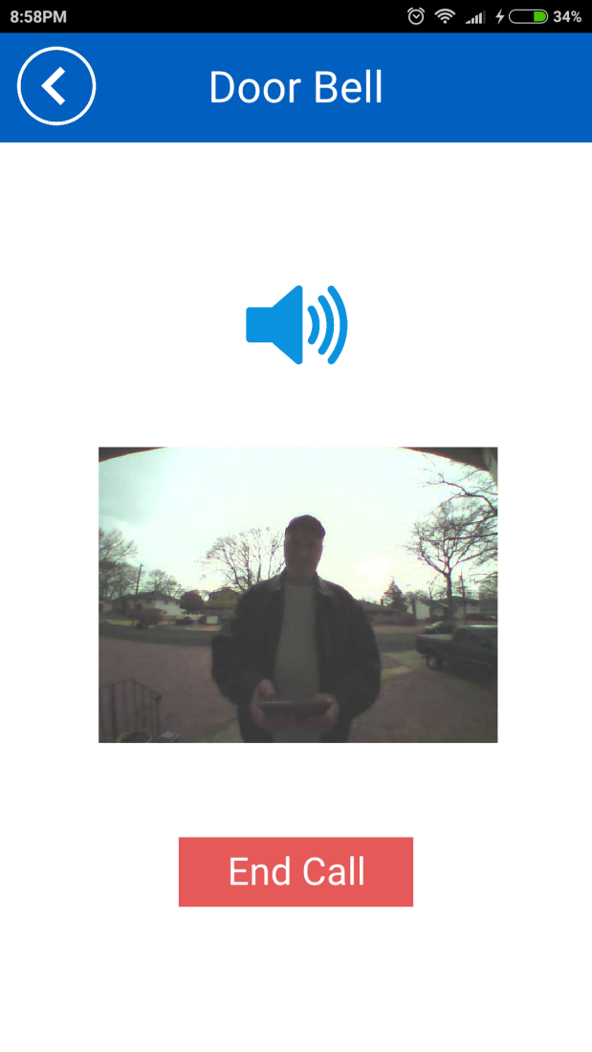
Software design (cont.)
Calling Doorbell

Slide 50
FUTURE WORKS

Slide 51
Future works
Add more sensors
CO detector, glass break sensor, etc…
Support video for calling doorbell
Track your visitor in real-time, not only static image
Self-setup at first
Fully automatic synchronization at first setup
Self-manage existing Camera IP
Full of features to manage viewing every camera IP

Slide 52

DEMO

Slide 53

QUESTION & ANSWER

Slide 54
THANK YOU

